Slide 1
Integration of Multiple Static Analysis Tools in a Single Interface
Status Quo
G. S. Varma

Slide 2
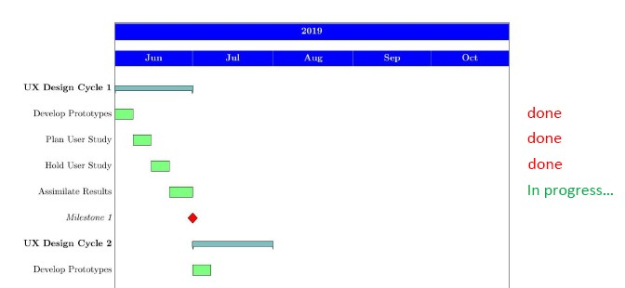
Time Plan

Slide 3
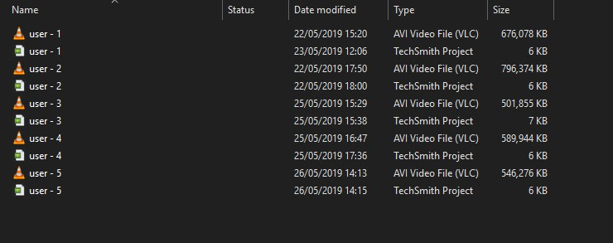
User Study ( Raw Data )

Slide 4
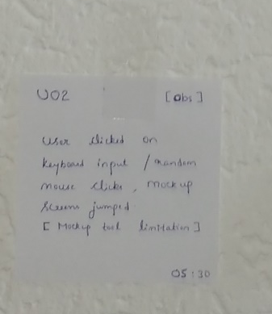
User Study ( Affinity Note)
Factual statements
Observations
Quotations

Slide 5
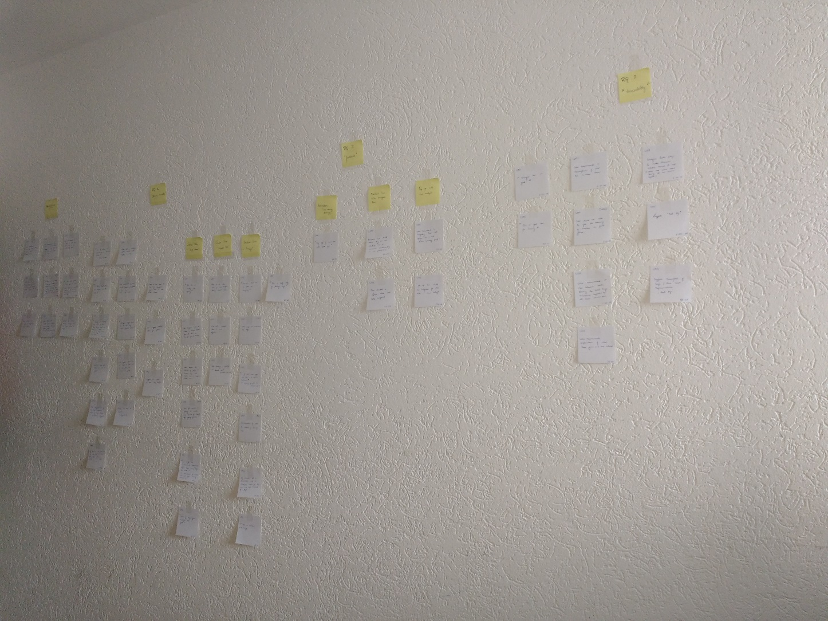
User Study ( Affinity Wall )

Slide 6
Limitations of user study
Small codebase ( limited presentation of bugs )
Easy bug ( to understand ex: FI_Empty )
No animation effects by mock up tool ( horizontal bar, icon tossing )
- but tried to help user understand the scenario

Slide 7
UX Cycle 1 Results – General
Tasks:
Filter Bugs
Find a common bug
Fix a bug Cognitive Walkthrough : easy to accomplish ( success )
Will the user realistically be trying to do this action?
Is control for action visible?
Is there link between control and action?
Is feedback appropriate?

Slide 8
UX Cycle 1 Results – RQ 1 : ... Display results
3 out of 5 voted for seperate lists
Reason: usability, easiness, less confusion
Recommendation: drop down results for better scalability

Slide 9
UX Cycle 1 Results – RQ 2: ... feedback
All users voted for 3 rd idea i.e., pending status + popup
Majority recommended for combining progress bar and popup
Disabled icon might mean unclickable

Slide 10
UX Cycle 1 Results – RQ: 3 - ... traceability
“ Interface is good “
recommends to add description about what the numbers mean
suggests tool tips for better understanding until user gets familiar
recommends to add third column showing total bugs reported by all tools

Slide 11
Research papers
The software engineering disciplines cited for UX Cycle 1
Complex datasets ( spreadsheets – column extensibility )
Issue tracker ( info overload )
Stack overflow

Slide 12
Research papers
The other software engineering disciplines for next UX Cycle
Complex datasets
Gaur et. al. speaks about the linear search problem
Compiler reporting
Horning et. al. – statistics ( also bugs not found )

Slide 13
Research papers
Refactoring tools
Dustinca – discoverability
Hayashi et. al. – task level commits
Gamification – Onboard phase
Usability Engineering

